Slide 1
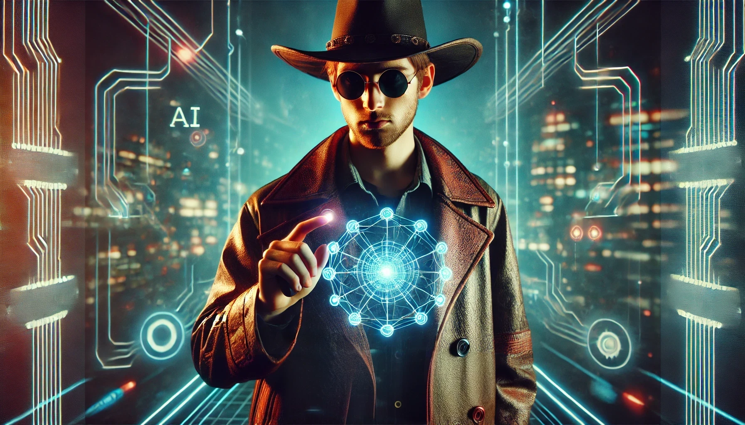
Understanding AI
Video Prompting and Generators

Slide 2
Lights, Camera, AI: The Future of Video Generation
This section delves into the remarkable advancements in artificial intelligence that are revolutionizing the world of video creation, opening up new creative possibilities and transforming the future of visual storytelling.

Slide 3
Introduction
Effortless Video Creation
Personalized Content
Time-Saving Workflow
Enhanced Creativity
AI-powered video generation tools allow users to create professional-quality videos with minimal time and effort.
Users can customize videos to their specific needs and preferences, making the content more engaging and relevant.
AI video generation streamlines the content creation process, reducing the time and resources required to produce high-quality videos.
The AI technology enables users to explore new creative possibilities and produce unique, visually striking videos.
AI video generation is revolutionizing the content creation landscape, empowering users to produce professional-quality videos with ease and efficiency.

Slide 4
What Are AI Video Generators?
User Inputs
Artificial Intelligence
Automated Video Creation
Customizable Outputs
AI video generators take in user-provided text, images, or other media as input to generate a video.
These platforms use advanced machine learning algorithms and neural networks to analyze the input and automatically create a cohesive video.
AI video generators can quickly and efficiently produce videos without the need for manual video editing or production skills.
Users can often customize the generated videos by specifying parameters like style, length, and content to match their specific needs.
AI video generators streamline the video creation process by leveraging artificial intelligence to automatically generate videos from user inputs, providing a convenient and efficient solution for content creation.

Slide 5
How AI Video Generators Work
Input Scripts and Ideas
Visual Asset Selection
Audio and Sound Integration
AI-Powered Video Assembly
The process begins with providing AI systems with scripts, storylines, or ideas for the video content. This can involve inputting text, dialogue, or a detailed outline of the desired video.
The AI will then select appropriate visual assets, such as 3D models, animations, and backgrounds, to bring the scripts and ideas to life. This step often involves the use of large databases of pre-created visual elements.
To create a fully immersive experience, the AI will incorporate audio elements, including background music, sound effects, and voice-over narration, to complement the visual components of the video.
The final step involves the AI system combining all the selected visual and audio elements into a cohesive, seamless video. This process often includes techniques like camera movements, scene transitions, and dynamic editing to ensure a polished, professional-looking result.

Slide 6
Text-to-Video: AI's Storytelling Magic
Text-to-video technology is revolutionizing the way content is created and shared. By harnessing the power of machine learning and video diffusion models, this innovative approach can transform written descriptions into captivating visual sequences. This capability empowers content creators, educators, and marketers to bring their ideas to life in dynamic and engaging ways.

Slide 7
Challenges & Ethical Considerations
Computational Requirements
Risk of Inappropriate Content
Need for Safeguards
Responsible deployment of AI video generators requires the establishment of comprehensive safeguards, including ethical guidelines, transparency measures, and user privacy protections to ensure the technology is used responsibly and in the public interest.
Developing and deploying AI video generators requires significant computational power, including high-performance GPUs, large memory capacity, and efficient algorithms to handle the complex processing involved.
AI video generators have the potential to generate content that may be inappropriate, biased, or even harmful, necessitating the implementation of robust content moderation and filtering mechanisms.
Addressing the computational requirements, risk of inappropriate content, and the need for safeguards is crucial for the responsible development and deployment of AI video generators, ensuring they are used in a manner that benefits society while mitigating potential harms.

Slide 8
The Future of AI Video Generation
Photorealistic Avatars
AI-generated avatars will become indistinguishable from real people, allowing for highly realistic virtual interactions and performances.
Personalized Video Content
AI systems will generate customized video content tailored to individual preferences, interests, and behaviors, providing a unique and engaging viewing experience.
Interactive Narratives
AI-powered interactive video experiences will allow users to make decisions that alter the course of the story, blurring the line between entertainment and participation.
Synthetic Environments
Fully artificial, photorealistic environments will be generated by AI, enabling the creation of immersive, virtual worlds for a wide range of applications, from gaming to training and simulation.
Automated Video Production
AI tools will streamline the video production process, automating tasks such as script writing, camera work, editing, and special effects, making video creation more accessible and efficient.

Slide 9
Exploring the Power of Text-to-Video Prompting

Slide 10
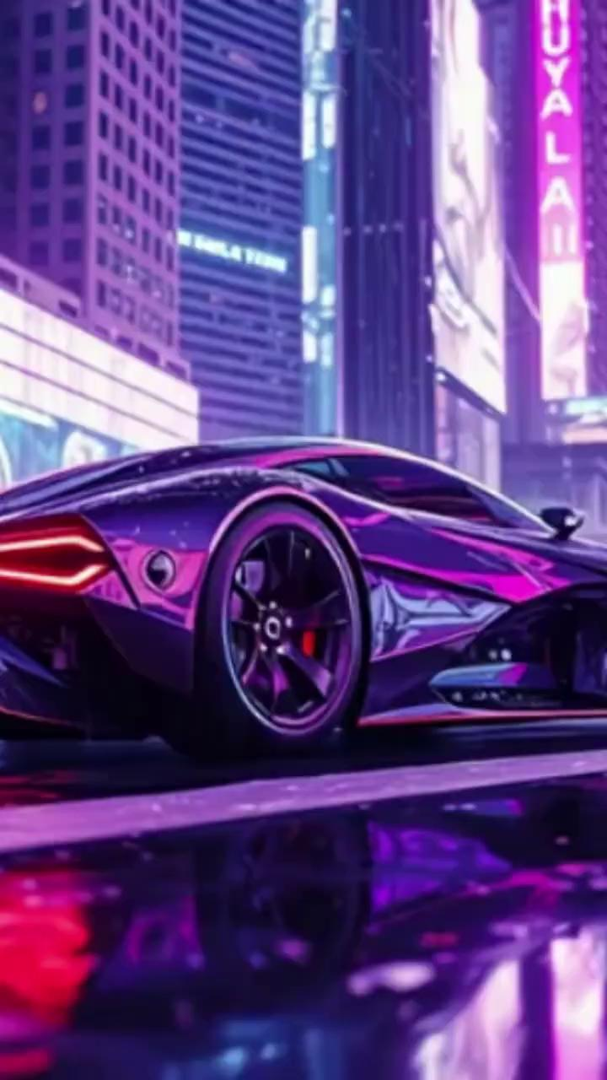
Marketing Video
The marketing video showcases a captivating cinematic experience, featuring a sleek and futuristic car gliding effortlessly through a sprawling cyberpunk cityscape. The video's dramatic lighting and dynamic camera angles create a mesmerizing and visually-striking atmosphere, drawing the viewer into this immersive and high-tech world.

Slide 11
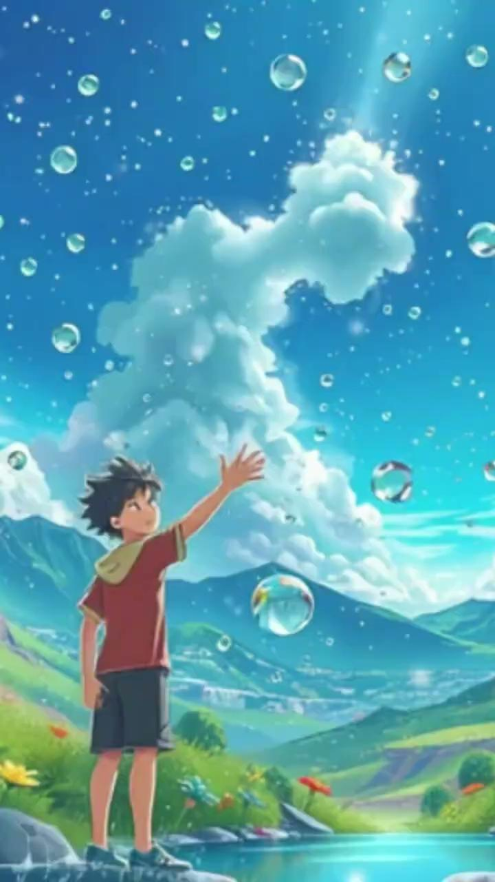
Educational Video
The educational video showcases a visually captivating explanation of the water cycle, featuring dynamic animations that illustrate the processes of evaporation, condensation, and precipitation. The video is accompanied by a clear and informative voiceover, guiding viewers through the intricate details of this natural phenomenon.

Slide 12
Social Media Content
Social media content that captures the attention of viewers is crucial in today's digital landscape. A snappy, TikTok-style video with eye-catching text animations, fast-paced music, and dynamic transitions can keep viewers engaged and interested in the message being conveyed.

Slide 13
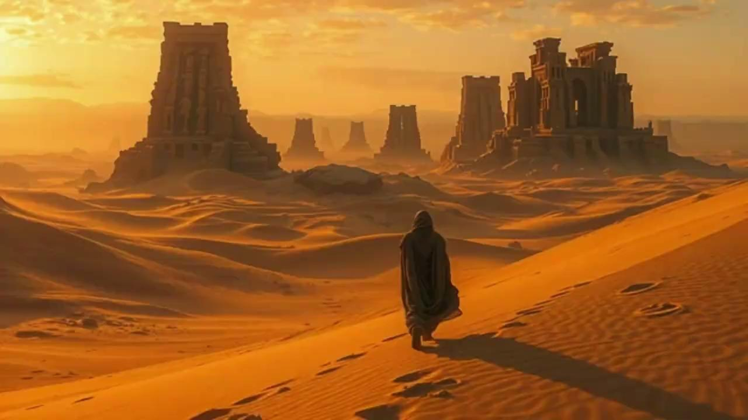
Storytelling & Film Concept
The cinematic sequence transports the viewer to a vast, awe-inspiring desert landscape, where the sweeping shots and intense soundtrack evoke a sense of mystery and grandeur. The atmospheric lighting effects set the tone, casting a warm, ethereal glow that complements the narrative and immerses the audience in the world of the story.

Slide 14
Mastering AI-Generated Video Prompts
This presentation will explore the art of crafting effective prompts for generating high-quality video content using AI technologies.
Ty Davis-Turcotte

Slide 15
Be Explicit About the Visual Style and Genre
Clearly define the artistic style
Establish the desired mood
Specify the cinematic tone
Specify whether the desired output should be realistic, animated, cinematic, or another style to ensure the AI model generates the appropriate visuals.
Convey the intended emotional tone, such as somber, whimsical, suspenseful, or upbeat, to guide the AI in creating the appropriate atmosphere.
Describe the cinematic approach, whether it should be documentary-style, futuristic, fantasy-driven, or another genre, to direct the AI in generating the right visual narrative.
By clearly defining the visual style, mood, and cinematic tone, you can provide the AI model with the necessary guidance to generate the desired output that aligns with your creative vision.

Slide 16
Define Camera Angles and Movements
Panning Shots
Horizontal camera movement that follows the action or shifts the viewer's perspective.
Zooming Shots
Adjusting the camera's focal length to smoothly transition between wide and close-up views.
Tracking Shots
Camera movement that physically follows the subject, creating a sense of movement and immersion.
Tilting Shots
Vertical camera movement that shifts the viewer's perspective up or down.
Dolly Shots
Camera movement achieved by mounting the camera on a wheeled platform and moving it forward or backward.

Slide 17
Use Detailed Character and Environmental Descriptions
Character Physical Traits
Character Attire
Surrounding Environment
Describe the character's height, build, facial features, and other distinctive physical characteristics.
Provide specific details about the character's clothing, accessories, and any unique or distinguishing elements of their outfit.
Paint a vivid picture of the character's immediate surroundings, including the location, lighting, textures, and any notable objects or elements.
By using detailed character and environmental descriptions, you can help the AI generate visuals that accurately reflect your intended narrative and setting.

Slide 18
Specify Motion and Timing for Dynamic Scenes
Employ verbs that convey motion
Incorporate timing cues
Evoke a sense of impact
Use action-oriented verbs like accelerate, plummet, ascend, or glide to create a sense of dynamism and movement in the scene.
Leverage words that indicate pacing, such as sudden, gradual, rapid, or leisurely, to establish a rhythm and tempo for the scene.
Utilize verbs that convey a strong impact, like crash, collide, or shatter, to heighten the intensity and drama of the scene.
By carefully selecting verbs that communicate motion, timing, and impact, you can craft AI-generated videos that captivate the viewer and immerse them in the dynamic scene.

Slide 19
Use Multi-Step Prompts for Storyboard-Style Output
Break down the task into multiple steps
Maintain a logical narrative flow
Provide a series of prompts that guide the AI through a storyboard-like process, with each step building upon the previous one.
Ensure the prompts create a cohesive, sequential narrative that flows naturally from one scene to the next.
Specify the required outputs at each step
Provide relevant details and constraints
Ask the AI to generate specific components like characters, settings, actions, or transitions at each stage of the storyboard.
Include specific details about the characters, mood, camera angles, and other elements to help the AI create a more coherent and visually appealing video sequence.
By structuring your prompts in a storyboard-like manner, you can guide the AI to generate a more cohesive and visually engaging video sequence that flows naturally from one scene to the next.

Slide 20
Example Prompt: Cinematic Sci-Fi Scene
The futuristic cityscape is a breathtaking sight, with towering skyscrapers and flying vehicles gliding through the air. Neon signs illuminate the rainy atmosphere, casting a moody, dramatic glow over the scene. Holograms flicker and dance, adding to the technological wonder of this futuristic world.

Slide 21
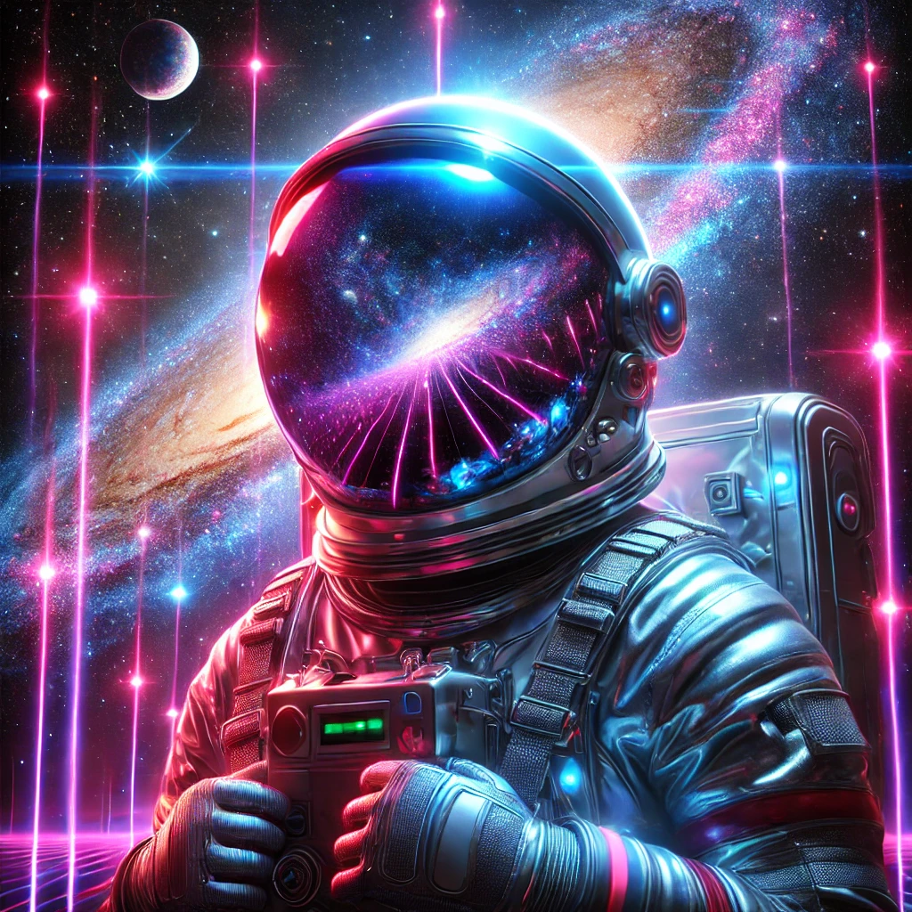
Example Prompt: Astronaut in Spaceship
The lone astronaut, clad in a bulky spacesuit, moves cautiously through the dimly lit, abandoned spaceship. The once-bustling vessel is now shrouded in eerie silence, save for the faint flickering of emergency lights that cast an unsettling glow on the astronaut's worried expression.

Slide 22
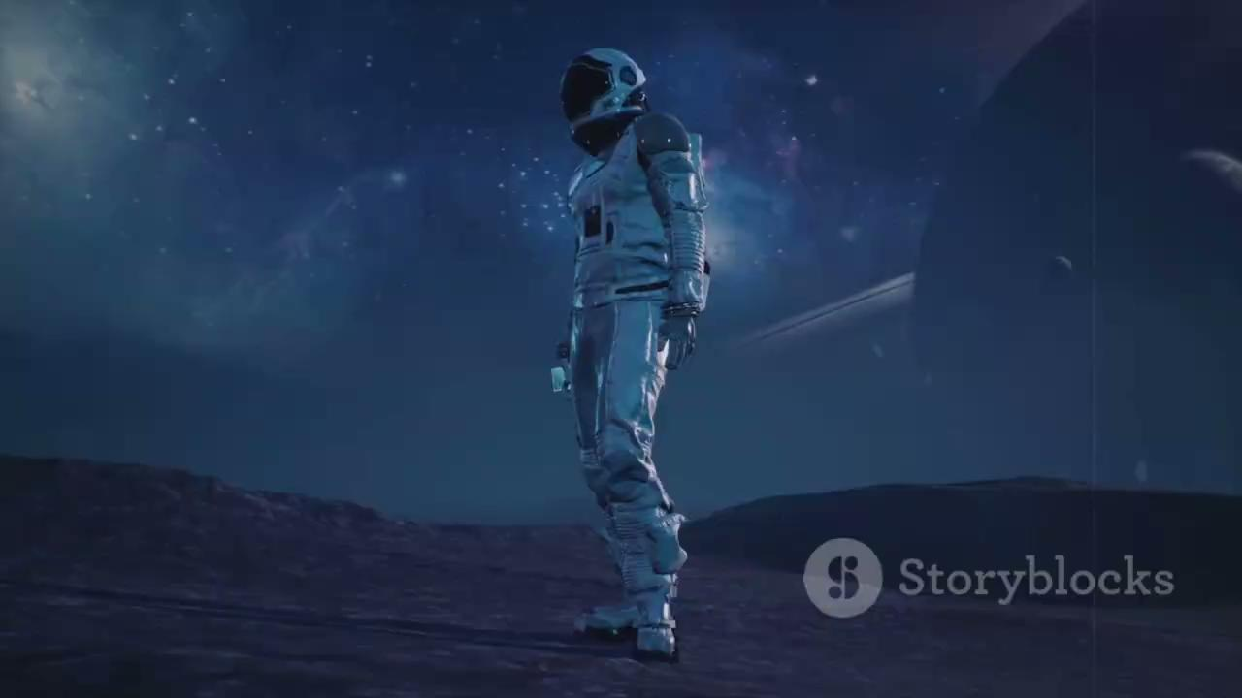

Slide 23
Example Prompt: Post-Apocalyptic Bounty Hunter
In a barren, post-apocalyptic landscape, a rugged bounty hunter stands vigilant, his cybernetic arm gleaming as he grips a plasma rifle, ever-watchful for signs of danger. This seasoned veteran, scarred from countless battles, scans the rust-colored horizon, his dusty leather coat a testament to the harsh realities of this new world.

Slide 24
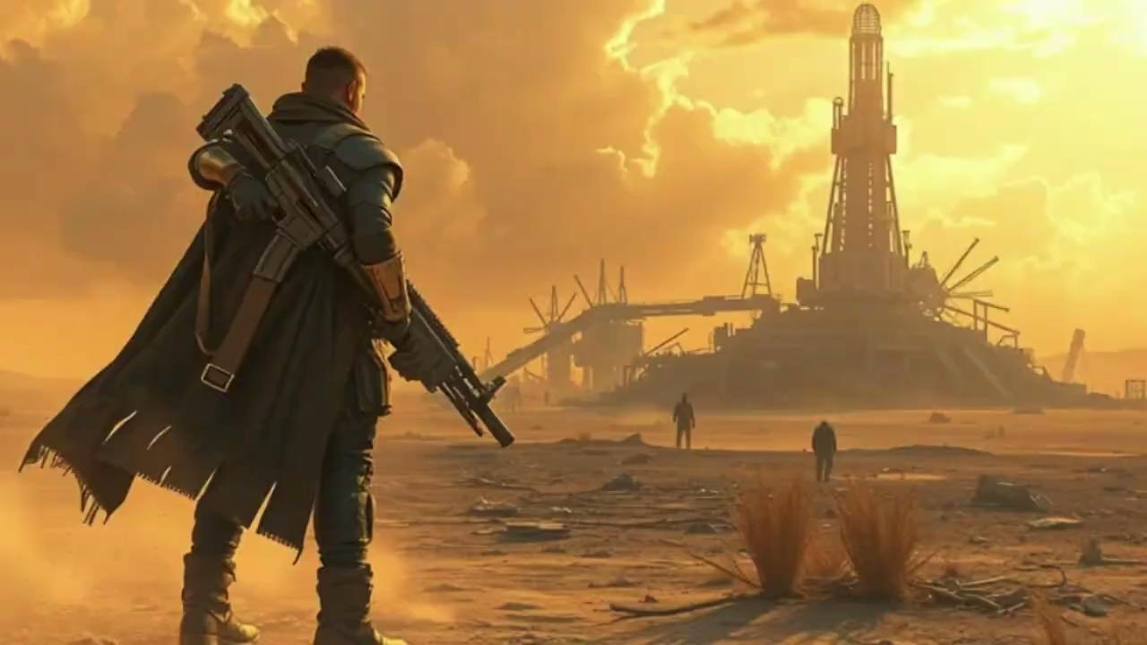

Slide 25
Mastering Text-to-Video Prompt: Unlock Cinematic Brilliance

Slide 26
Introduction: Unleashing Creativity with Text-to-Video
Revolutionizing Video Creation
Personalized Content at Scale
Text-to-video prompting empowers users to generate high-quality video content quickly and easily, without the need for complex video editing skills.
Text-to-video prompting enables the creation of customized video content tailored to individual preferences and needs, empowering users to express their unique voice.
Unlocking AI's Potential
Streamlining Workflows
By harnessing the power of AI-driven video generation, users can unleash their creativity and explore new realms of visual storytelling.
This technology can greatly enhance and streamline video production workflows, making the process more efficient and accessible for a wide range of users.
By exploring the power of text-to-video prompting, this presentation will highlight how AI-driven video generation can unlock new possibilities for creative expression and video content creation.

Slide 27
Prompt Formula: Subject + Action + Environment + Style
This slide explores the first prompt formula, which focuses on defining the key elements of a successful prompt. The main subject, their action, the surrounding environment, and the desired visual style are the four crucial components that work together to create a compelling and specific prompt. By carefully considering each of these elements, you can craft prompts that effectively communicate your creative vision and inspire the desired outcome.

Slide 28
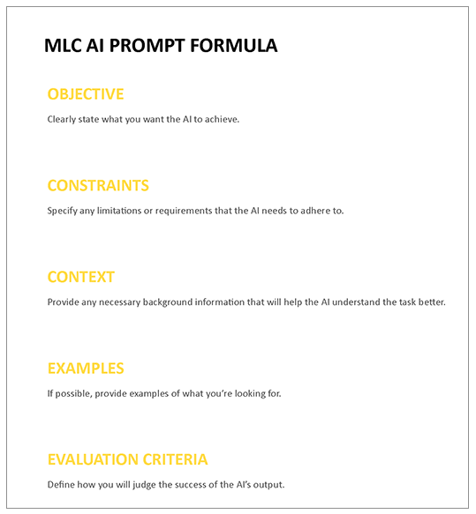
Prompt Formula: Subject + Movement + Scene Description + Camera Technique + Lighting + Atmosphere
This slide delves into a more comprehensive prompt formula, incorporating additional details that can elevate your visuals. The subject's movement, a detailed scene description, camera techniques, lighting conditions, and the overall atmosphere all play a crucial role in crafting an immersive and visually captivating prompt.

Slide 30
Prompt Formula: Subject + Action + Setting + Time of Day + Weather Conditions + Camera Angle
This prompt formula provides a structured approach to crafting vivid, immersive scene descriptions. By specifying the subject, their action, the setting, the time of day, the weather conditions, and the camera angle, writers can paint a comprehensive picture that engages the reader's senses and imagination.

Slide 31
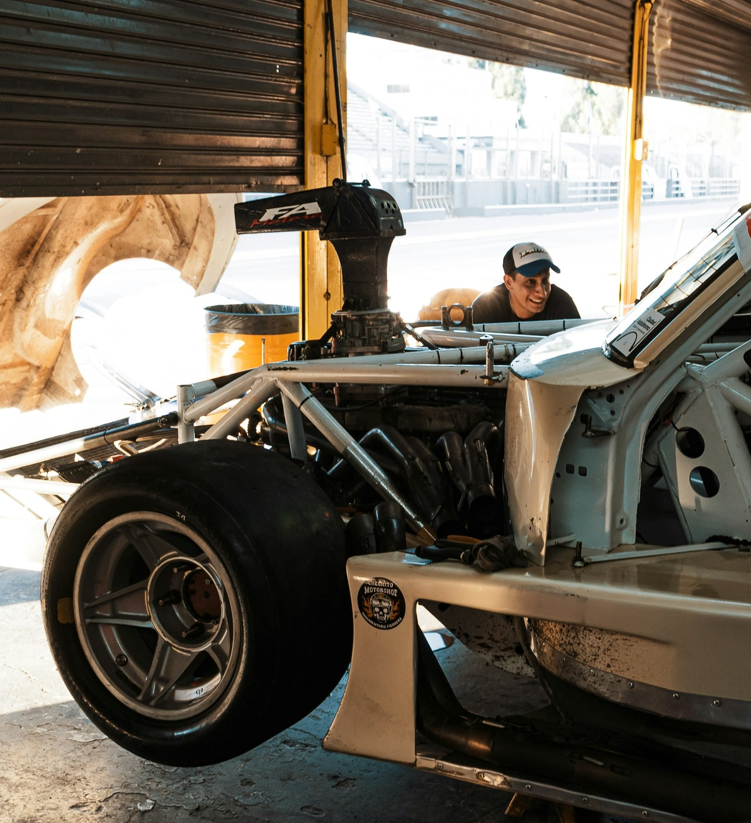
Prompt Formula: Character + Activity + Location + Era + Visual Style + Sound Elements
This prompt formula provides a structured approach to crafting immersive narrative scenarios. By considering the character, their actions, the setting, the historical context, the visual style, and the accompanying audio elements, writers can weave together a rich tapestry of sensory details that bring stories to life.

Slide 32
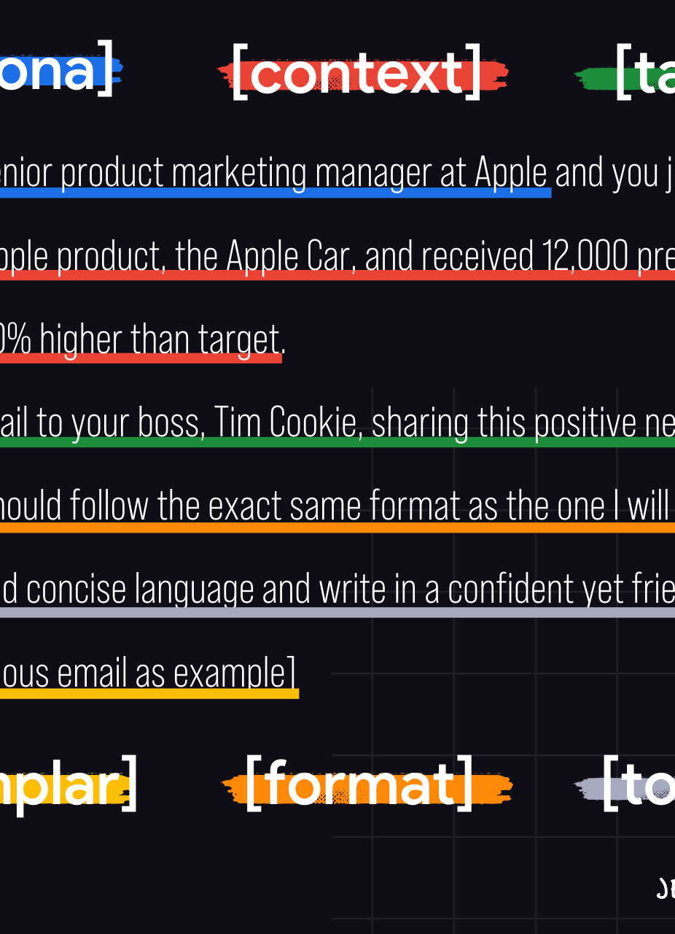
Prompt Formula: Object + Interaction + Background + Lighting + Camera Movement + Mood
The prompt formula emphasizes the interplay between a captivating object, its dynamic interaction with the surrounding environment, and the thoughtful integration of compelling background, lighting, camera movement, and overall mood. This approach aims to create a visually striking and immersive scene that engages the viewer's imagination.

Slide 33
Putting it All Together: Crafting Effective Prompts
Combine Prompt Elements
Incorporate Creative Flair
Leverage a mix of different prompt elements like task, style, and mood to create comprehensive and compelling text-to-video prompts.
Infuse your prompts with imaginative language, vivid descriptions, and a touch of creativity to inspire unique and engaging video outputs.
Specify Details and Constraints
Test and Iterate
Provide clear and specific instructions about the desired video content, length, genre, and other parameters to guide the generation process.
Experiment with different prompt formulations, evaluate the results, and refine your approach to continuously improve the effectiveness of your prompts.
By combining various prompt elements, specifying details, incorporating creativity, and iterating on your approach, you can craft effective text-to-video prompts that unlock the full potential of generative AI technologies.

Slide 34
Conclusion: Unleash Your Cinematic Potential
Mastering text-to-video prompting unlocks a world of creative potential, empowering you to transform your ideas into captivating, cinematic realities. By harnessing the power of AI-driven video generation, you can unleash your cinematic vision, crafting visuals that captivate and inspire your audience. This concluding segment encourages you to embrace the boundless possibilities of this transformative technology and explore the full extent of your creative abilities.

